Slide 1
CSE246: Algorithms
Lecture 1

Slide 2

Algorithm

Slide 3
Algorithm
A procedure for solving a problem in terms of
  the actions to be executed, and
  the order in which these actions are to be executed
is called an algorithm.
Correctly specifying the order in which the actions are to be executed is important.

Slide 4
Algorithm
Consider the “rise-and-shine algorithm” followed by one junior executive for getting out of bed and going to work
Consider the “rise-and-shine algorithm”
  (1) Get out of bed,
  (2) take off pajamas,
  (3) take a shower,
  (4) get dressed,
  (5) eat breakfast,
  (6) carpool to work.
This routine gets the executive to work well prepared to make critical decisions.

Slide 5
Algorithm
Suppose that the same steps are performed in a slightly different order:
  (1) Get out of bed,
  (2) take off pajamas,
  (3) get dressed,
  (4) take a shower,
  (5) eat breakfast,
  (6) carpool to work.
In this case, our junior executive shows up for work soaking wet.

Slide 6
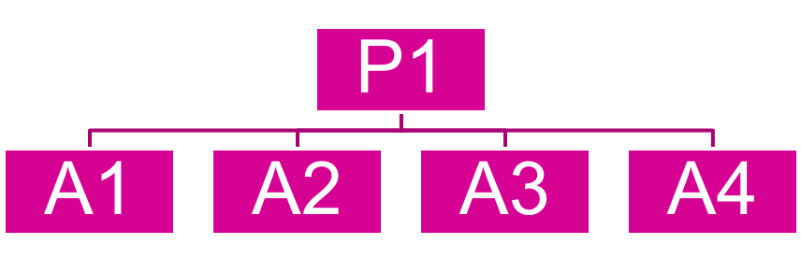
Algorithm
Suppose we have a problem P1 to solve
We have many algorithms.
Which one of the above algorithms will choose?
Analyzing an algorithm
  Predicting the resources that the algorithm requires
  Resources include
    Memory
    Computational time (usually most important)
Notes:
6

Slide 7
Running Time
Factors affecting the running time
  computer
  compiler
  algorithm used
  input to the algorithm
    typically, the input size (number of items in the input) is the main consideration
      E.g. sorting problem ⇒ the number of items to be sorted
      E.g. multiply two matrices together ⇒ the total number of elements in the two matrices
Notes:
7

Slide 8
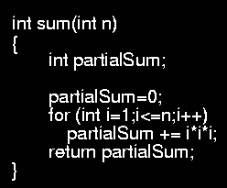
Example
Calculate
Lines 1 and 4 count for one unit each
Line 3: executed N times, each time four units
Line 2: (1 for initialization, N+1 for all the tests, N for all the increments) total 2N + 2
total cost: 6N + 4 ⇒ O(N)
1
2
3
4
1
2N+2
4N
1
Notes:
8

Slide 9
Time Complexity
Time complexity: A measure of the amount of time required to execute an algorithm
Factors that should not affect time complexity analysis:
  The programming language chosen to implement the algorithm
  The quality of the compiler
  The speed of the computer on which the algorithm is to be executed
13-9

Slide 10
Time Complexity
Analysis is based on the amount of work done by the algorithm
Time complexity expresses the relationship between the size of the input and the run time for the algorithm
Usually expressed as a proportionality, rather than an exact value
13-10

Slide 11

Why should we care????

Slide 12
Let see….
Suppose Rahim and Karim are two students and they both have given a same assignment.
  Determine whether a number n is prime or not.
  Example of prime numbers: 2,3,5,7

Slide 13
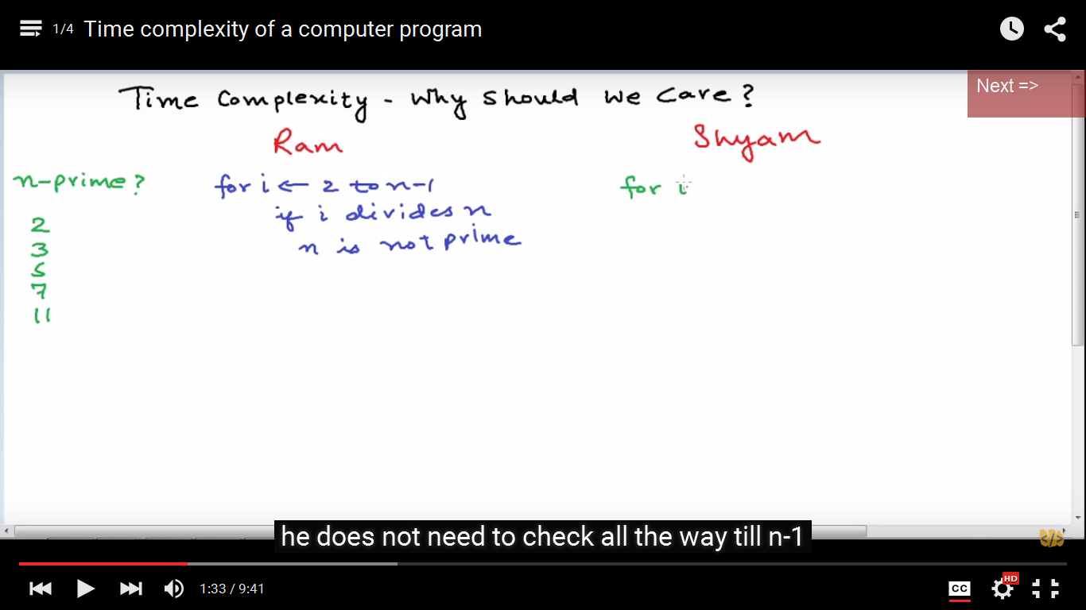
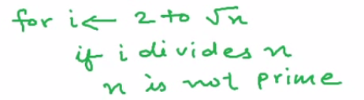
Let see….
Rahim
Karim
N-2 divisions
√N-2 divisions
Both the algorithms will give the right answer
But for a large value of n , Rahim’s program
will run for several days!!!!!!!!

Slide 14
Typical Running Time Functions
1 (constant running time):
  Instructions are executed once or a few times
logN (logarithmic)
  A big problem is solved by cutting the original problem in smaller sizes, by a constant fraction at each step
N (linear)
  A small amount of processing is done on each input element
N logN
  A problem is solved by dividing it into smaller problems, solving them independently and combining the solution

Slide 15
Typical Running Time Functions
N² (quadratic)
  Typical for algorithms that process all pairs of data items (double nested loops)
N³ (cubic)
  Processing of triples of data (triple nested loops)
N^{K} (polynomial)
2^{N} (exponential)
  Few exponential algorithms are appropriate for practical use

Slide 16
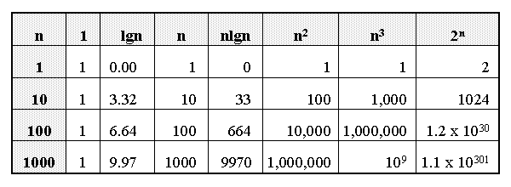
Growth of Functions

Slide 17
Introduction
Why are asymptotic notations important?
They give a simple characterization of an algorithm’s efficiency.
They allow the comparison of the performances of various algorithms.

Slide 18
Algorithm Complexity
Worst Case Complexity:
  the function defined by the maximum number of steps taken on any instance of size n
Best Case Complexity:
  the function defined by the minimum number of steps taken on any instance of size n
Average Case Complexity:
  the function defined by the average number of steps taken on any instance of size n
Notes:
18

Slide 19
Worst- / average- / best-case
Worst-case running time of an algorithm
  The longest running time for any input of size n
  An upper bound on the running time for any input
  ⇒ guarantee that the algorithm will never take longer
  Example: Sort a set of numbers in increasing order; and the data is in decreasing order
  The worst case can occur fairly often
Best-case running time
  sort a set of numbers in increasing order; and the data is already in increasing order
Average-case running time
  May be difficult to define what “average” means
Notes:
19

Slide 20
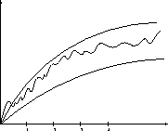
Doing the Analysis
It’s hard to estimate the running time exactly
  Best case depends on the input
  Average case is difficult to compute
  So we usually focus on worst case analysis
    Easier to compute
    Usually close to the actual running time
Strategy: find a function (an equation) that is an upper bound to the actual function (actual number of steps, memory usage, etc.)
Upper bound
Actual function
Lower bound
Notes:
20

Slide 21
Doing the Analysis
An exact computation of worst-case running time can be difficult
Function may have many terms:
4n2 - 3n log n + 17.5 n - 43 n⅔ + 75
Ignore:
  constant factors and
  small inputs.

Slide 22
Asymptotic notations
Upper bound O(g(N))
Lower bound Ω(g(N))
Tight bound Θ(g(N))
Notes:
22

Slide 23
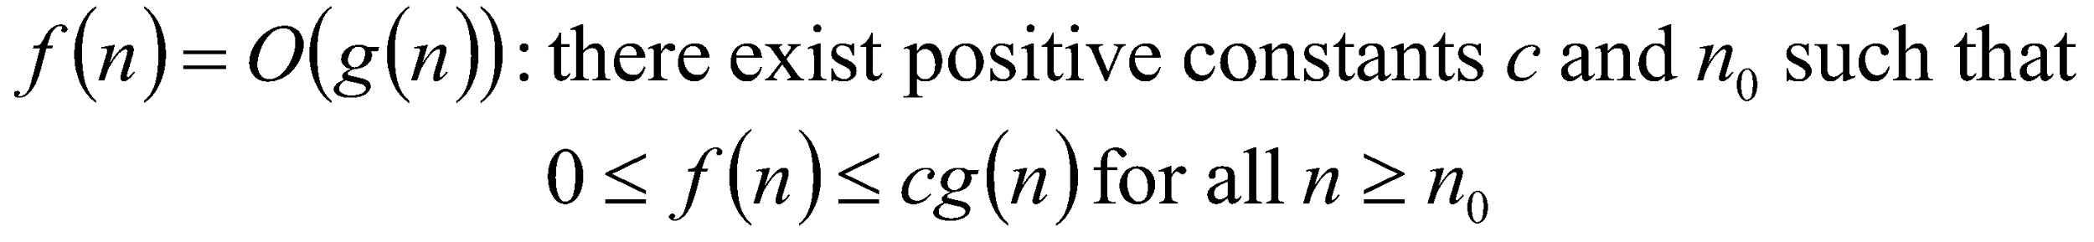
Big-O
What does it mean?
  If f(n) = O(n²), then:
    f(n) can be larger than n² sometimes, but…
    We can choose some constant c and some value n₀ such that for every value of n larger than n₀ : f(n) < cn²
    That is, for values larger than n₀, f(n) is never more than a constant multiplier greater than n²
    Or, in other words, f(n) does not grow more than a constant factor faster than n².
23

Slide 24
Visualization of O(g(n))
cg(n)
f(n)
n₀
24

Slide 25
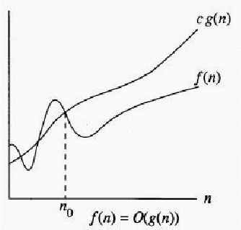
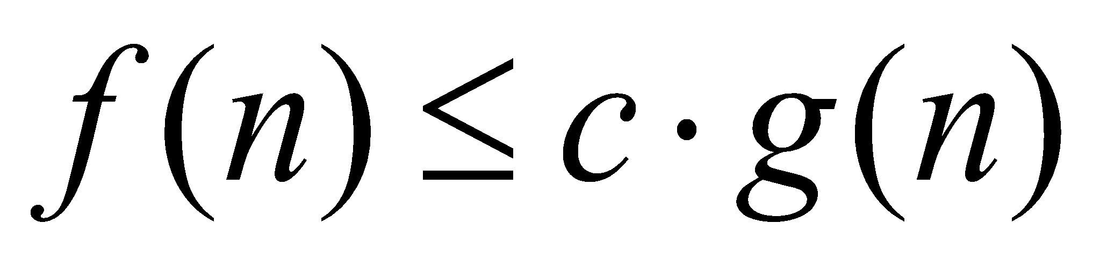
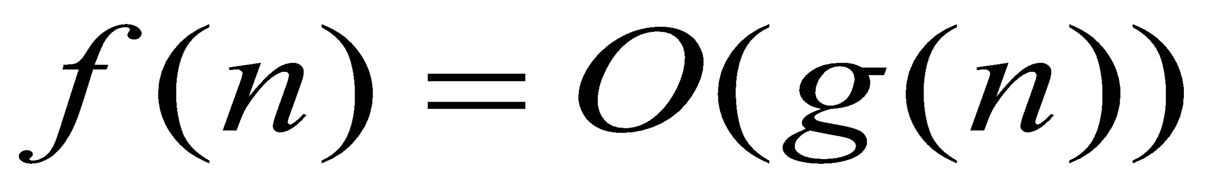
Big - O
if we can prove that
for constant c and n₀ where
  c≥0 and n₀≥1
Then we can say
C | n | f(n)=3n+2 | c.g(n)=c.n
4 | 1 | 5 | 4
4 | 2 | 8 | 8
4 | 3 | 11 | 12
4 | 5 | 17 | 20
Example: 1
Lets say f(n)=3n+2 and g(n)=n
We have to prove:
f(n) ≤ cg(n)
3n+2 ≤c.n

Slide 26
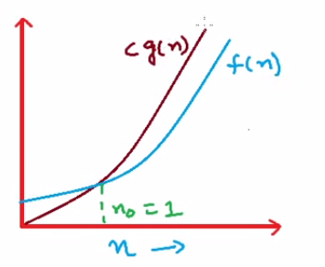
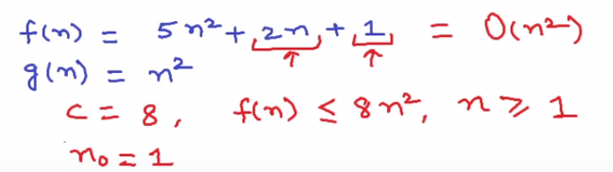

Slide 27
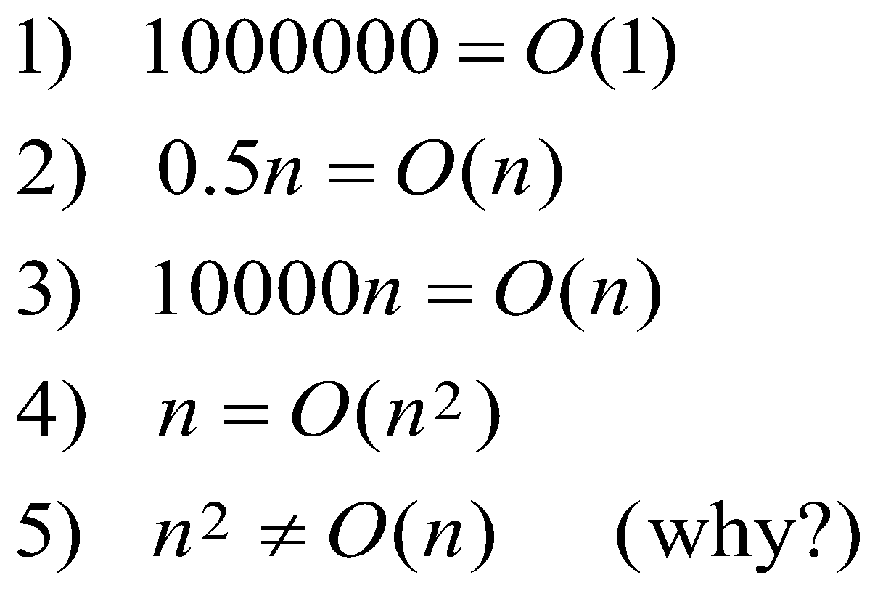
Big - O
In other words, g(n) bounds f(n) from above (for large n’s) up to a constant.
Examples:

Slide 28
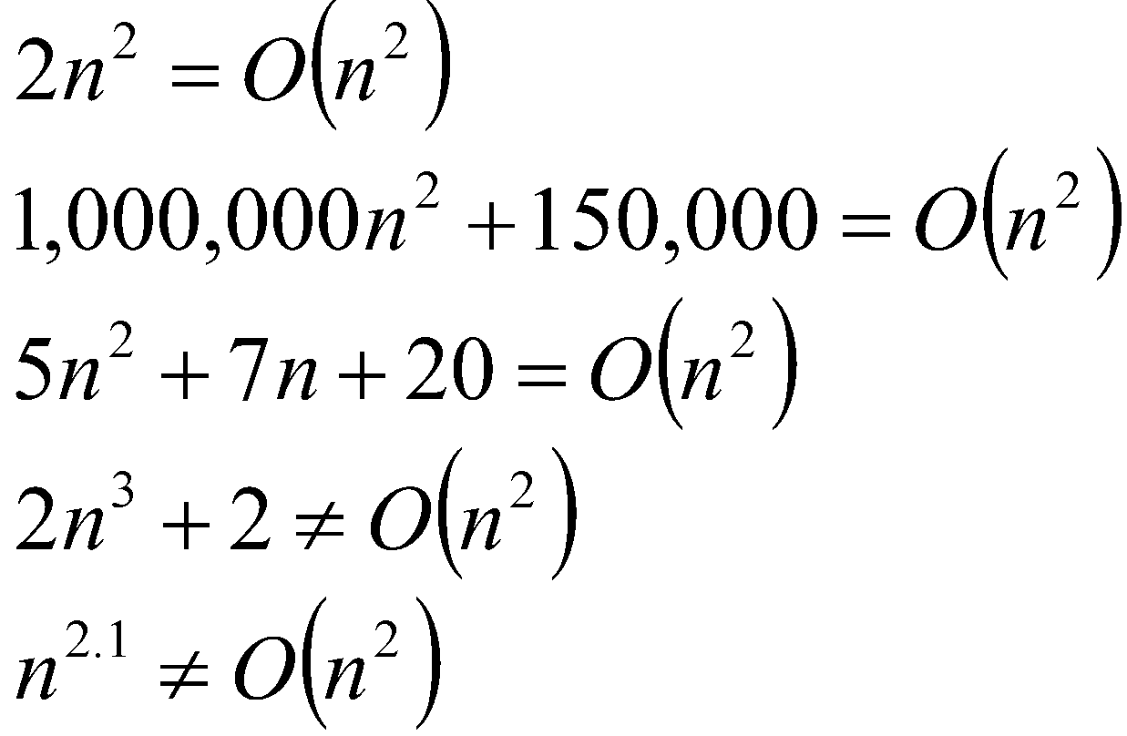
Big-O
28

Slide 29
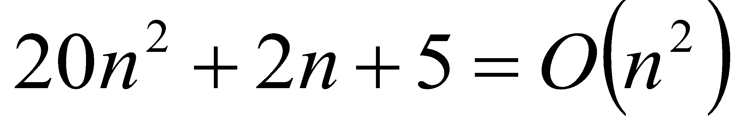
More Big-O
Prove that:
Let c = 21 and n₀ = 4
21n² > 20n² + 2n + 5 for all n > 4
n² > 2n + 5 for all n > 4
TRUE
29

Slide 30
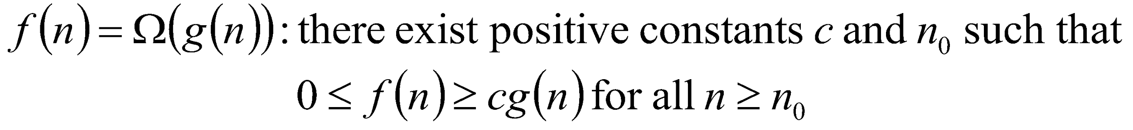
Big Omega – Notation
Ω() – A lower bound
  n² = Ω(n)
  Let c = 1, n₀ = 2
  For all n ≥ 2, n² > 1 × n
30

Slide 31
Visualization of Ω(g(n))
f(n)
cg(n)
n₀
31

Slide 32
Visualization of Ω(g(n))
Example: 1
Lets say f(n)=3n+2 and g(n)=n
We have to prove:
f(n) ≥ cg(n)
3n+2 ≥c.n
f(n)
cg(n)
n₀
Example: 1
So we can say:
for c=1 and for all n≥1
f(n) ≥ cg(n)
C | n | f(n)=3n+2 | c.g(n)=c.n
1 | 1 | 5 | 1
1 | 2 | 8 | 2
1 | 3 | 11 | 3
1 | 4 | 14 | 4

Slide 33
Visualization of Ω(g(n))
Example: 2
Lets say f(n)=3n+2 and g(n)=n²
We have to prove:
f(n) ≥ cg(n)
3n+2 ≥c.n
f(n)
cg(n)
n₀
We can not find such a constant c so that for all n ≥1 can satisfy our condition.

Slide 34
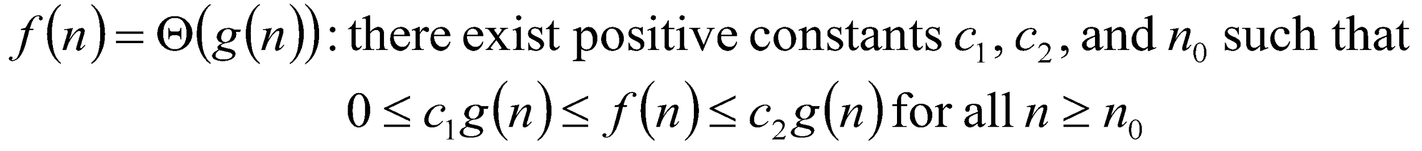
Θ-notation
Big-O is not a tight upper bound. In other words n = O(n²)
Θ provides a tight bound
In other words,
34

Slide 35
Visualization of Θ(g(n))
c₂g(n)
f(n)
c₁g(n)
n₀
35

Slide 36
Visualization of Θ(g(n))
Example:
Lets say f(n)=3n+2 and g(n)=n
We have to prove:
f(n) ≤ c₂ g(n)
3n+2 ≤ c₂.n
c₂ | n | f(n)=3n+2 | c₂.g(n)=c₂.n
4 | 1 | 5 | 4
4 | 2 | 8 | 8
4 | 3 | 11 | 12
4 | 5 | 17 | 20
c₁ | n | f(n)=3n+2 | c₁.g(n)=c₁.n
1 | 1 | 5 | 1
1 | 2 | 8 | 2
1 | 3 | 11 | 3
1 | 4 | 14 | 4
Secondly
We have to prove:
f(n) ≥ c1g(n)
3n+2 ≥c1.n
36

Slide 37
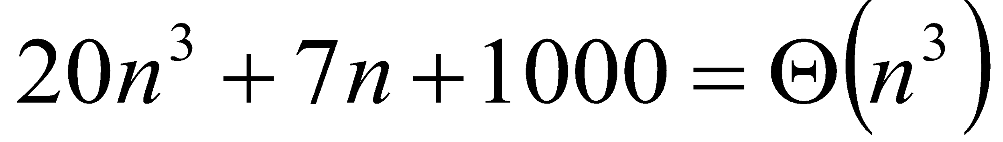
Example 2
Prove that:
Let c = 21 and n₀ = 10
21n³ > 20n³ + 7n + 1000 for all n > 10
n³ > 7n + 5 for all n > 10
TRUE, but we also need…
Let c = 20 and n₀ = 1
20n³ < 20n³ + 7n + 1000 for all n ≥ 1
TRUE
37

Slide 38
Common time complexities
BETTER
WORSE
O(1) constant time
O(log n) log time
O(n) linear time
O(n log n) log linear time
O(n²) quadratic time
O(n³) cubic time
O(2^{n}) exponential time
38

Slide 39

O(1) constant
Algorithms whose solutions are independent of the size of the problem’s inputs are said to have constant time complexity
Constant time complexity is denoted as O(1)

Slide 40
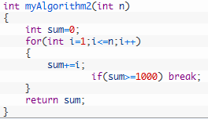
O(n)
Loops
  at most the running time of the statements inside the for-loop (including tests) times the number of iterations.
  O(N)

Slide 41

O(n²)
Nested loops
  the running time of the statement multiplied by the product of the sizes of all the for-loops.
  O(N²)
Notes:
41

Slide 42
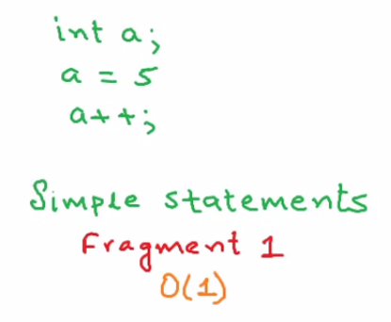
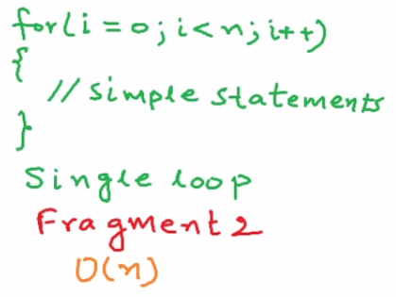
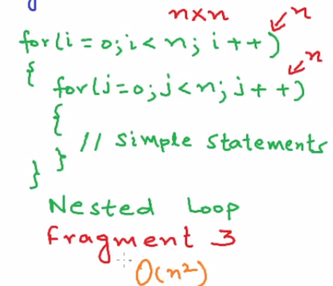
Some common rules
42

Slide 43
O(n²)
int x = 0;
for ( int j = 1; j <= n/2; j++ )
for ( int k = 1; k <= n*n; k++ )
x = x + j + k;
Outer loop executes n/2 times.
For each of those times, inner loop executes n² times,
so the body of the inner loop is executed (n/2)*n² = n³/2 times.
The algorithm is O(n³) .

Slide 44
O(n²)
int x = 0;
for ( int j = 1; j <= n; j++ )
for ( int k = 1; k < 3*j; k++ )
x = x + j;
When j is 1, inner loop executes 3 times;
when j is 2, inner loop executes 3*2 times; …
when j is n, inner loop executes 3*n times.
In all the inner loop executes 3+6+9+…+3n = 3(1+2+3+…+n)
= 3n²/2 + 3n/2 times.
The algorithm is O(n²).

Slide 45
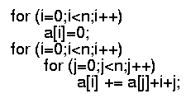
Consecutive statements
  These just add
  O(N) + O(N²) = O(N²)
Notes:
45

Slide 46
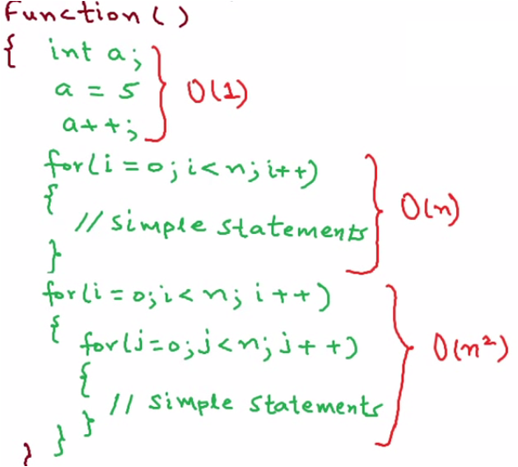
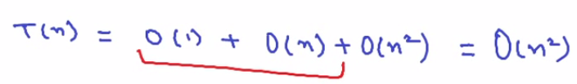
46

Slide 47
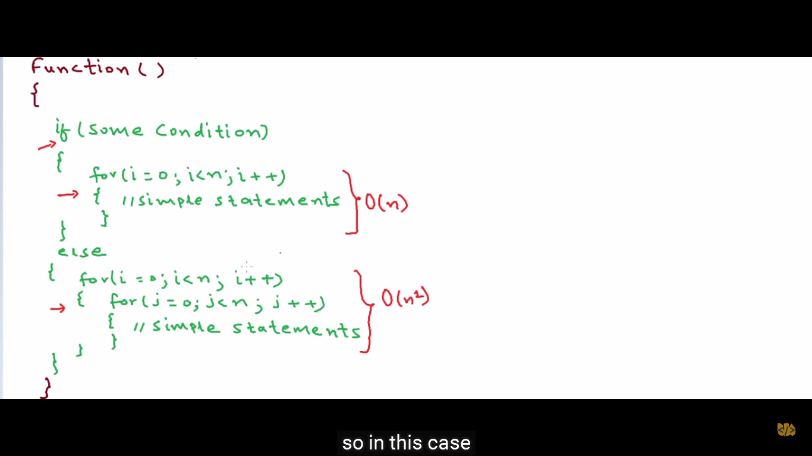
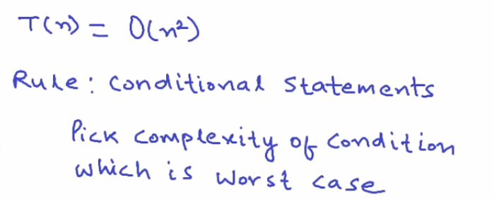
47

Slide 48
Example
Code:
a = b;
Complexity:
48
Notes:
48
constant

Slide 49
Example
Code:
sum = 0;
for (i=1; i <=n; i++)
sum += n;
Complexity:
49
Notes:
49
linear

Slide 50
Example
Code:
sum = 0;
for (j=1; j<=n; j++)
for (i=1; i<=j; i++)
sum++;
for (k=0; k<n; k++)
A[k] = k;
Complexity:
50
Notes:
50
N squared == 1 + 2 + … + N

Slide 51
Example
Code:
sum1 = 0;
for (i=1; i<=n; i++)
for (j=1; j<=n; j++)
sum1++;
Complexity:
51
Notes:
51
Obviousy n squared

Slide 52
Example
Code:
sum2 = 0;
for (i=1; i<=n; i++)
for (j=1; j<=i; j++)
sum2++;
Complexity:
52

Slide 53
Example
Code:
sum1 = 0;
for (k=1; k<=n; k*=2)
for (j=1; j<=n; j++)
sum1++;
Complexity:
53
Notes:
53
outer loop O(lg N), inner loop (N) == O (N lg N) by product rule

Slide 54
Example
Code:
sum2 = 0;
for (k=1; k<=n; k*=2)
for (j=1; j<=k; j++)
sum2++;
Complexity:
54
Notes:
54
outer O (lg N) inner = sum of powers of 2 which is linear since
The sum of powers of 2 dividing into N is 2N so its O (N lg N) by product rule

